Slide 1


2024
Positioning in the digital twin - a comparison on the fidelity with real data
Xuan Zhang
20 May, 2025

Slide 2
Content
Simulated Environment
Least Square Solution
Ray Tracing Simulation
Results

Slide 3
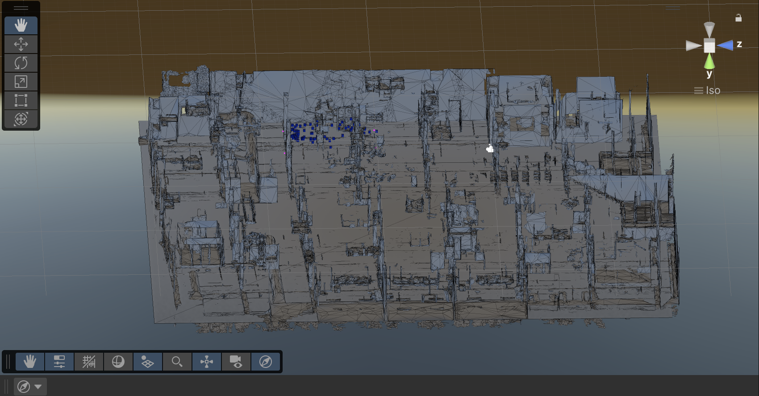
Simulated Environment
Unity Version 6
Building Model Format Imported as .obj
Visual Studio code version 1.99.3
Unity's scripting language : C sharp
Visualization of charts : Matlab

Slide 4
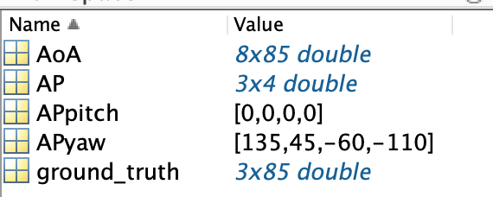
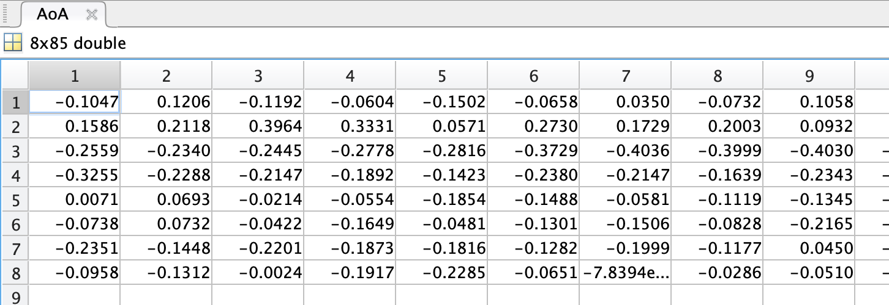
Input data - Take made-data-test-1.mat as an instance

Slide 5
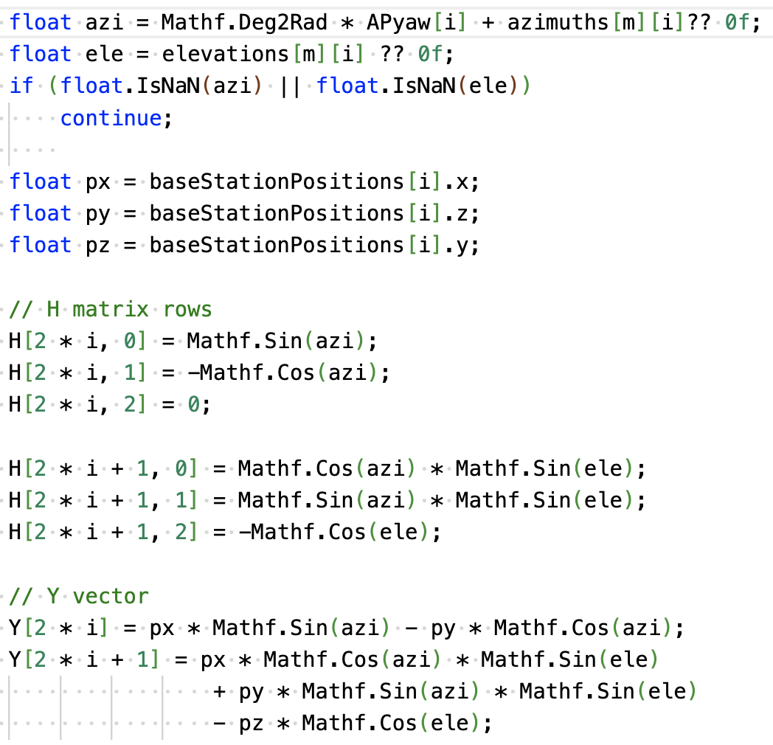
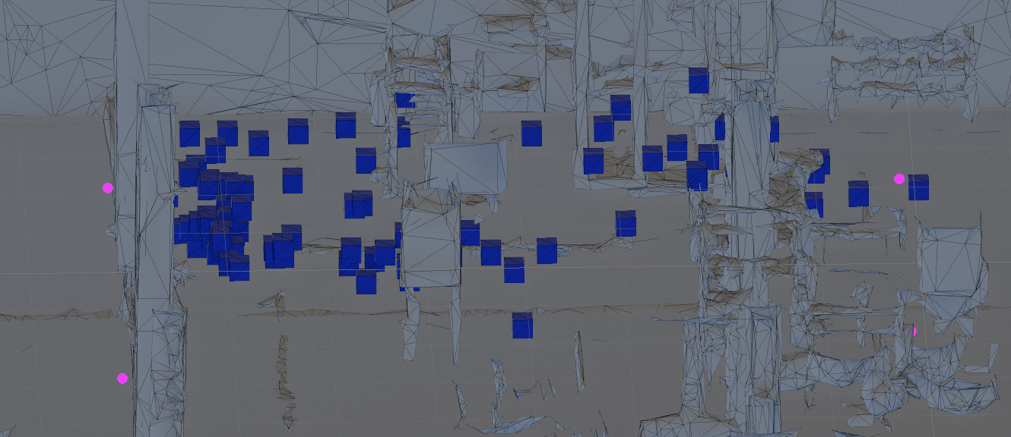

Least Square Solution
The red circle is the AP, and each blue square is the estimated position of each data.

Slide 6
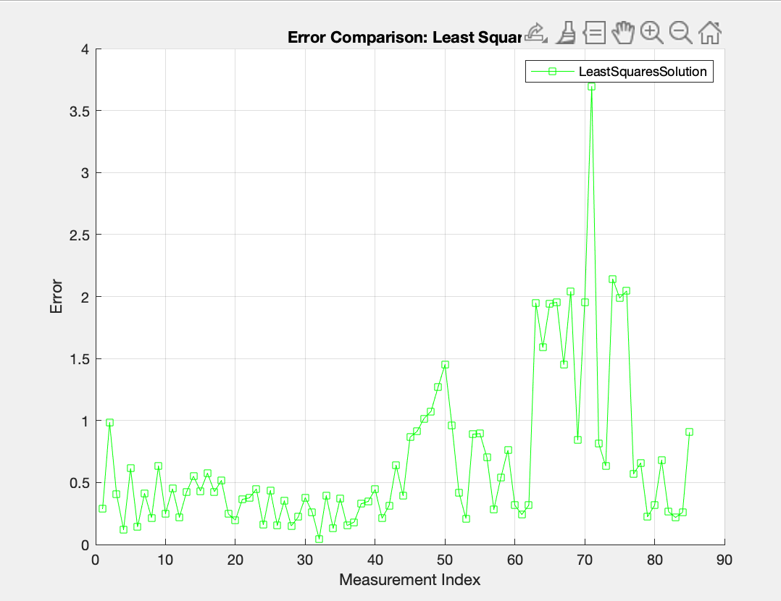

Least Square Solution - Error estimation
The error is obtained by calculating the Euclidean distance between the estimated position and the ground truth:
Most of the errors are less than 1, but there are still some points that exceed 2.

Slide 7
Ray Tracing - Estimating location based on voxel-based crossing counts
[Start]
↓
[Input AoA measurements, AoA distributions , 3D digital twin]
↓
[For each Anchor point (4 AP), sample l angles AoA distributions]
↓
[Generate 4 × l rays from all BS using sampled directions]
↓
[For each voxel (X_k) in the scene:]
─ Collect all rays intersecting X_k
─ Count valid n-ray combinations (each from different AP)
↓
[Compute β_k = number of valid combinations]
↓
[Find voxel with maximum β_k → Estimated Position]
↓
[Output: Most likely voxel X_k]
Parameters
AoA distributions
the number of rays per AP
max Reflections : Maximum number of reflections per ray
voxelSize : The step size of the voxelized rays

Slide 8
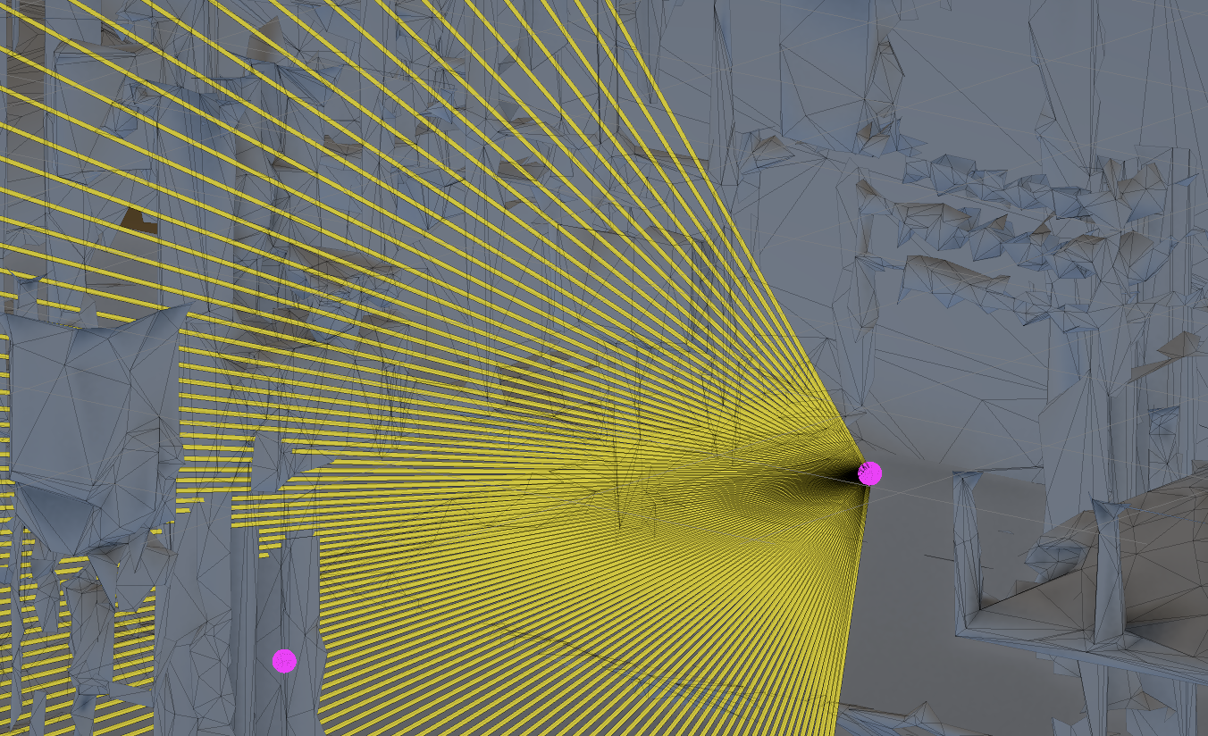
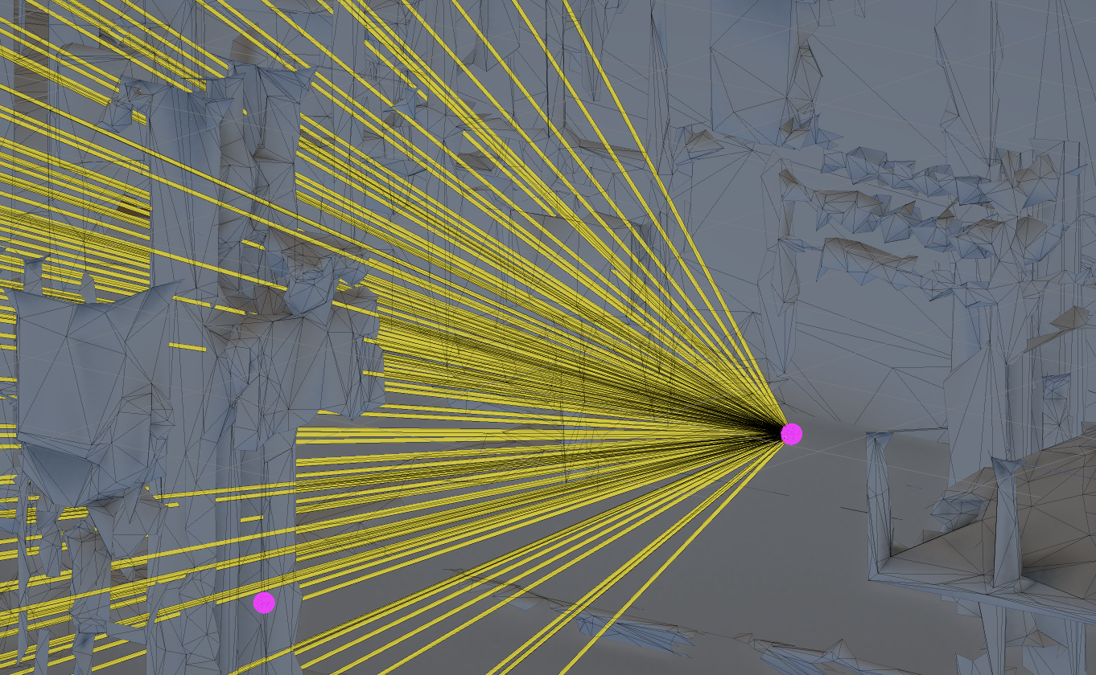
Ray Tracing Simulation - AoA distributions
Uniform Distribution
~(MinDegree of AoA,MaxDegree of AoA)
e.g. rays number = 100
Gaussian Distribution
~(0, (MaxDegree - MinDegree)/6)
e.g. rays number = 100

Slide 9
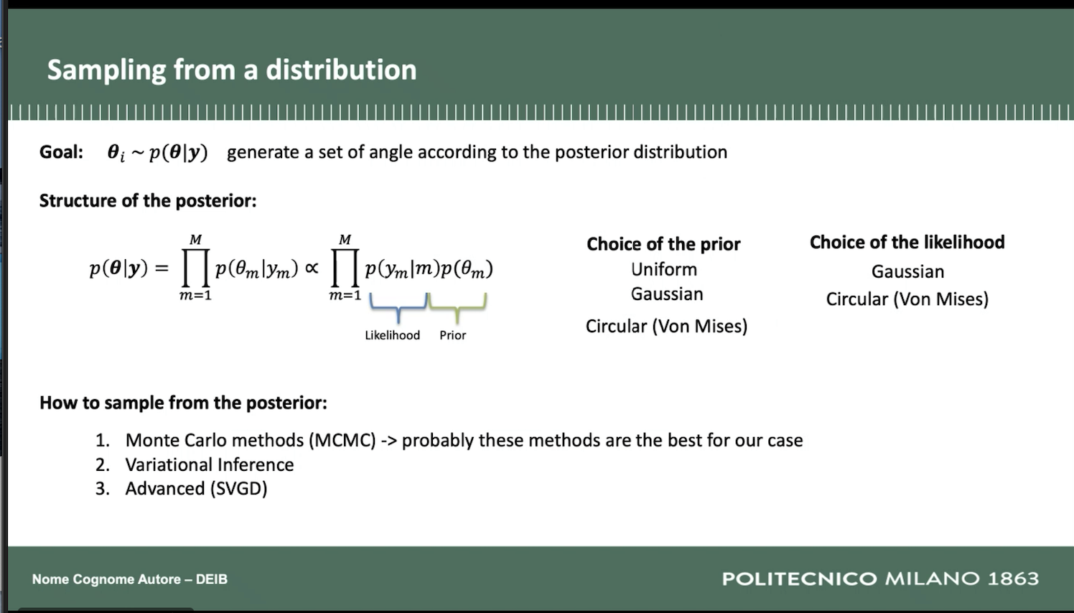
Ray Tracing Simulation - 概率分布+MCMC采样

Slide 10
Ray Tracing Simulation - - the number of rays per AP & max reflections
Ray Quantity Controls Sampling Density
A larger number of rays improves spatial coverage and increases the probability of hitting the target region. However, more rays also increase computation time.
→ Trade-off between localization accuracy and performance.
Maximum Reflections Simulate Multipath Effects
Reflections allow simulation of real-world signal behaviors such as bouncing off walls or objects. Limiting reflection depth helps manage computational complexity.
→ Helps analyze how multipath affects positioning results.

Slide 11
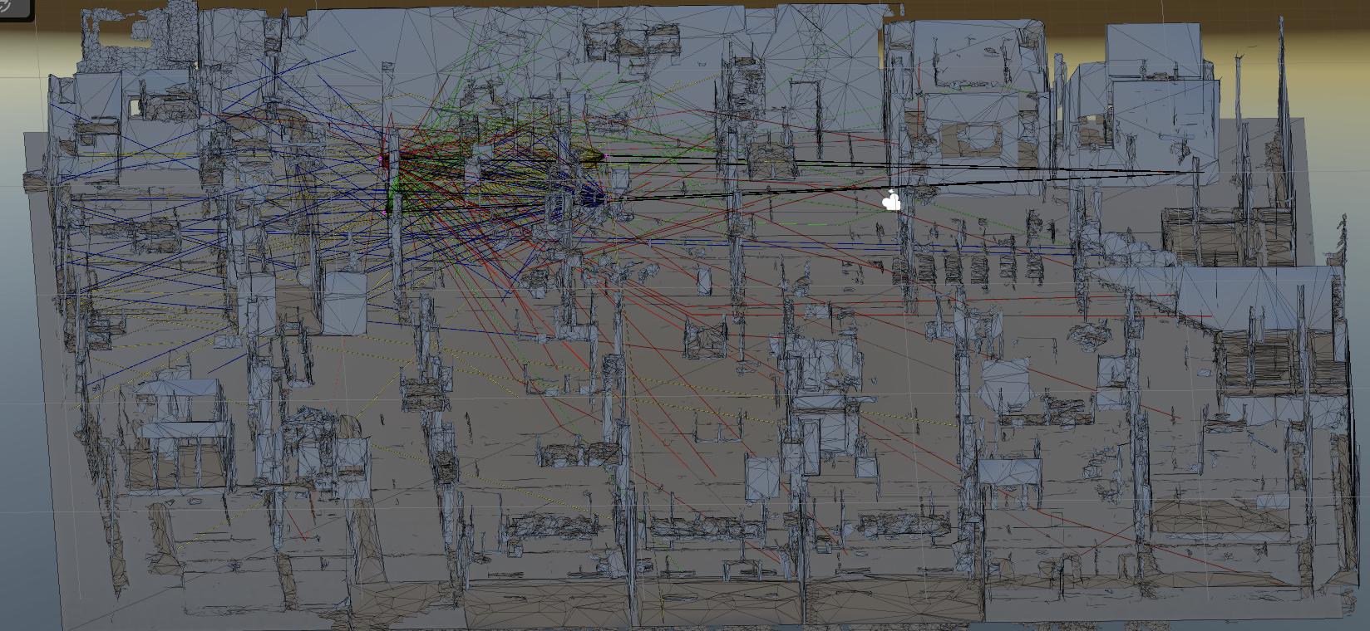
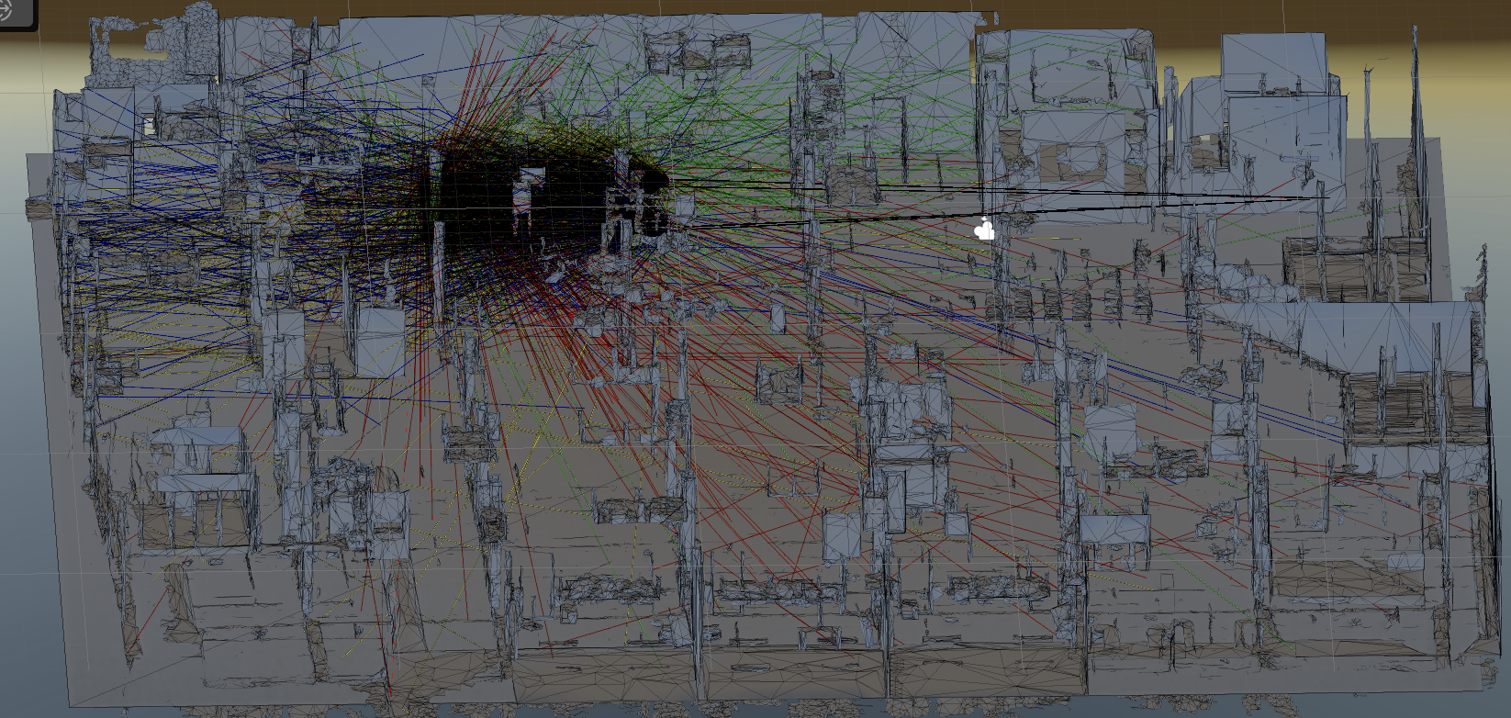
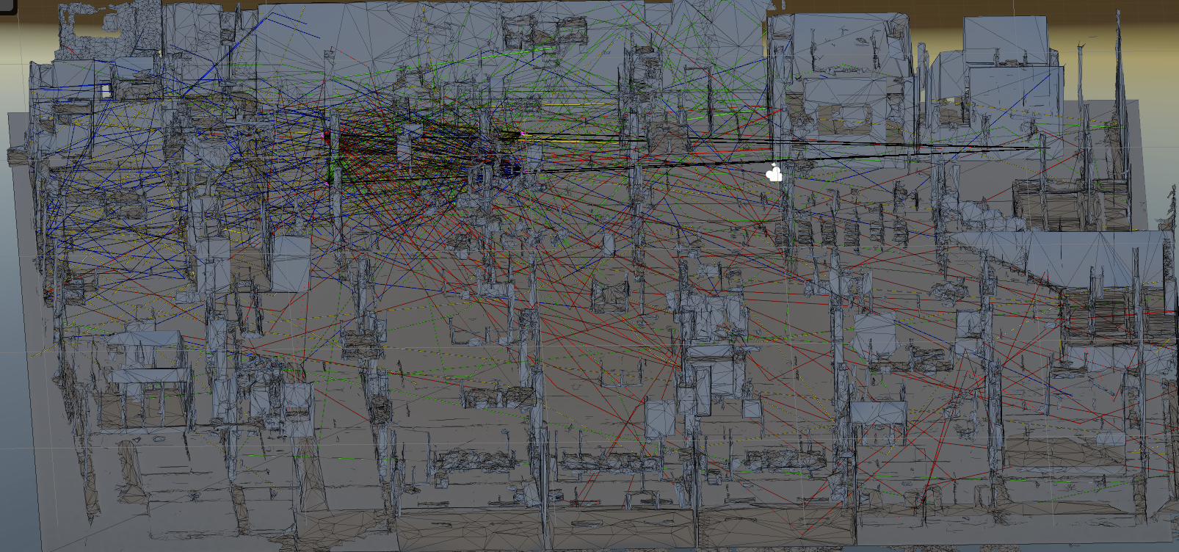
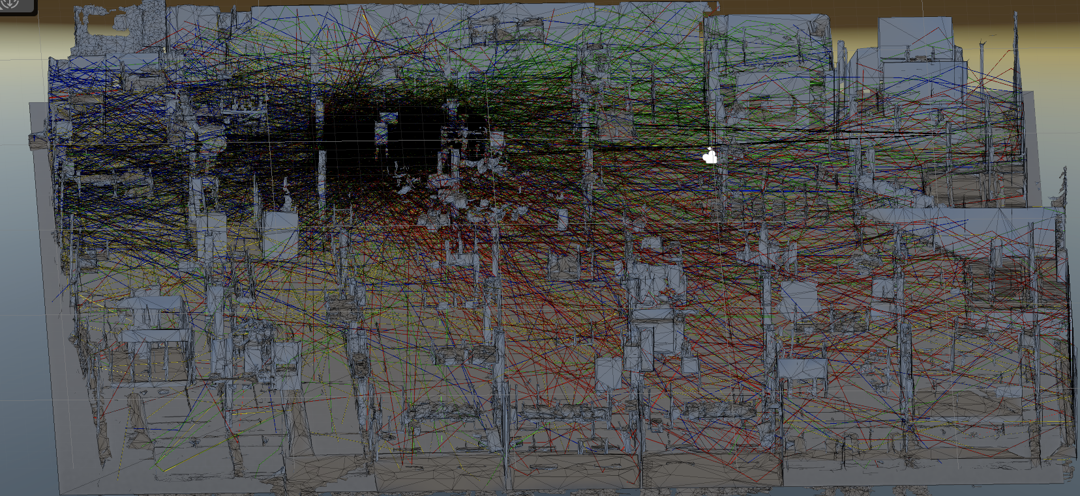
Ray Tracing Simulation - - the number of rays per AP & max reflections
50
&
2
300
&
2
50
&
5
300
&
5

Slide 12
Ray Tracing - DDA Algorithm for 3D Ray Traversal
The Digital Differential Analyzer (DDA) algorithm is an efficient method for simulating the path of a ray through a 3D voxel grid.
Purpose:
To determine which voxels a ray intersects and in what order, as it moves through a 3D environment.
Core Steps:
1. Initialize the ray’s origin and direction.
2. Calculate the step distances to the next voxel boundaries along X, Y, and Z axes.
3. Step through the grid voxel-by-voxel, always moving in the axis with the smallest next intersection.
4. Update voxel indices and continue until the ray exits the grid or reaches a termination condition.
Advantages:
✓ Only intersects relevant voxels
✓ Efficient and fast for dense grids
✓ Simple to implement with integer arithmetic
Application in This System:
In our Unity-based Monte Carlo localization framework, DDA is used to count how many rays pass through each voxel. This information helps estimate the target’s location by identifying high-density voxel hits.

Slide 13
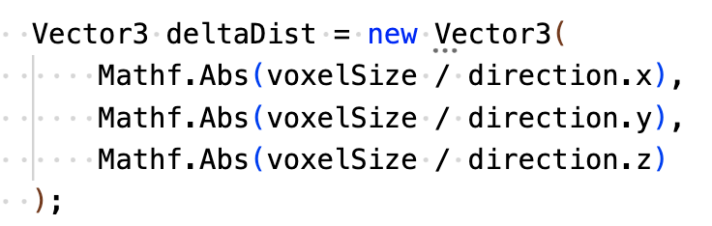
Ray Tracing - DDA Algorithm for 3D Ray Traversal
Basic Steps:
Initialize the ray origin as (x0,y0,z0), with direction vector (dx,dy,dz)
Compute the step size along each axis:
tDeltaX=voxelSize /∣dx∣,
tDeltaY=voxelSize /∣dy∣,
tDeltaZ=voxelSize /∣dz∣
3. Initialize tMaxX , tMaxY, and tMaxZ:
These indicate the distances to the next voxel boundary along each axis.
4. Iterate:
Compare tMaxX, tMaxY, tMaxZ, and take a step along the axis with the smallest value.
Update the corresponding tMax.

Slide 14
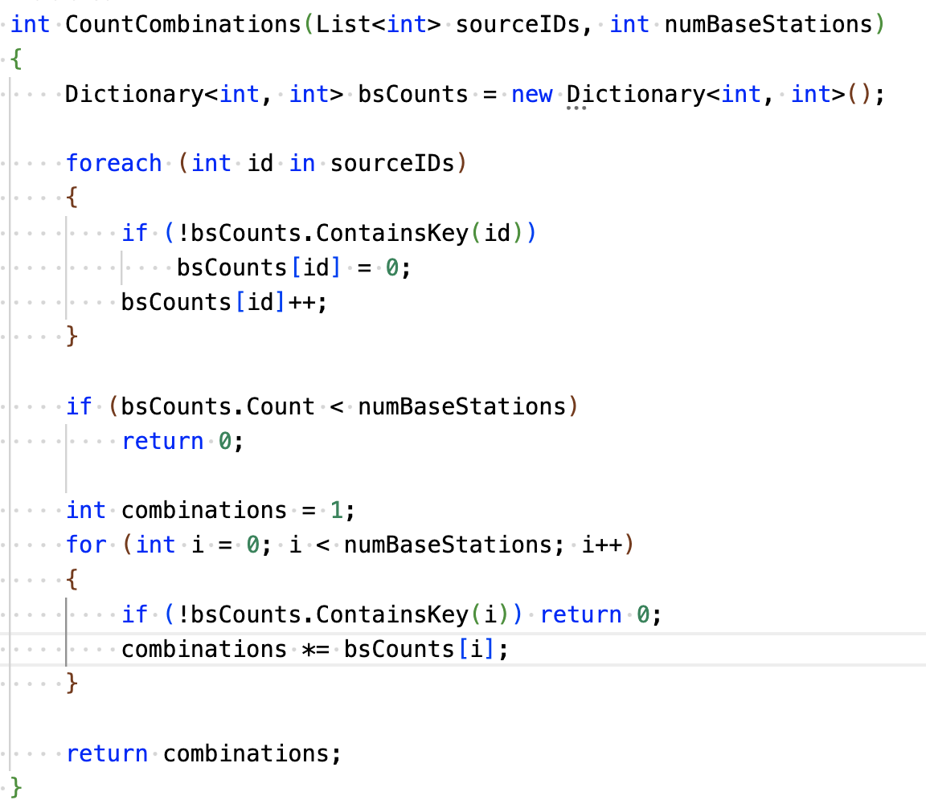
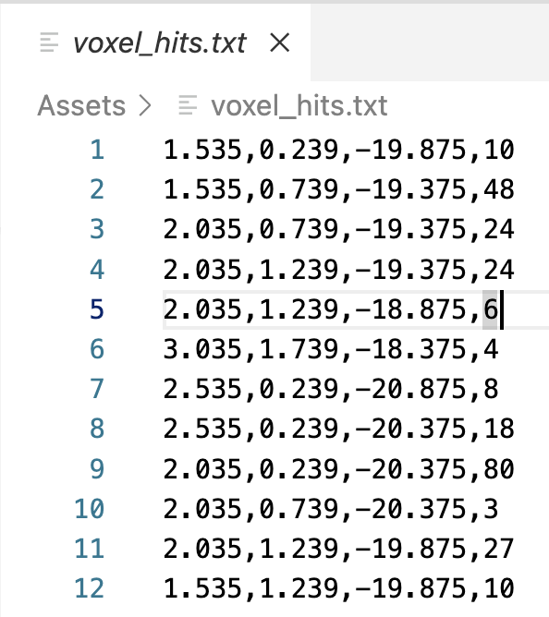
Ray Tracing Simulation - Compute β_k = number of valid combinations
(x0,y0,z0,beta_k) are saved in voxel_hit.txt
The total number of combinations is the product of the ray counts from each involved base station.

Slide 15
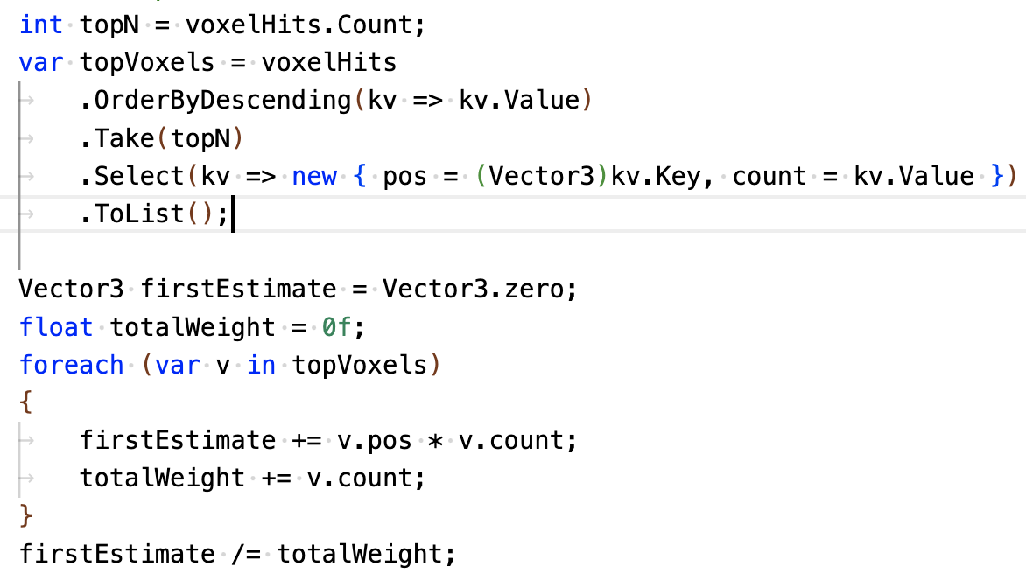
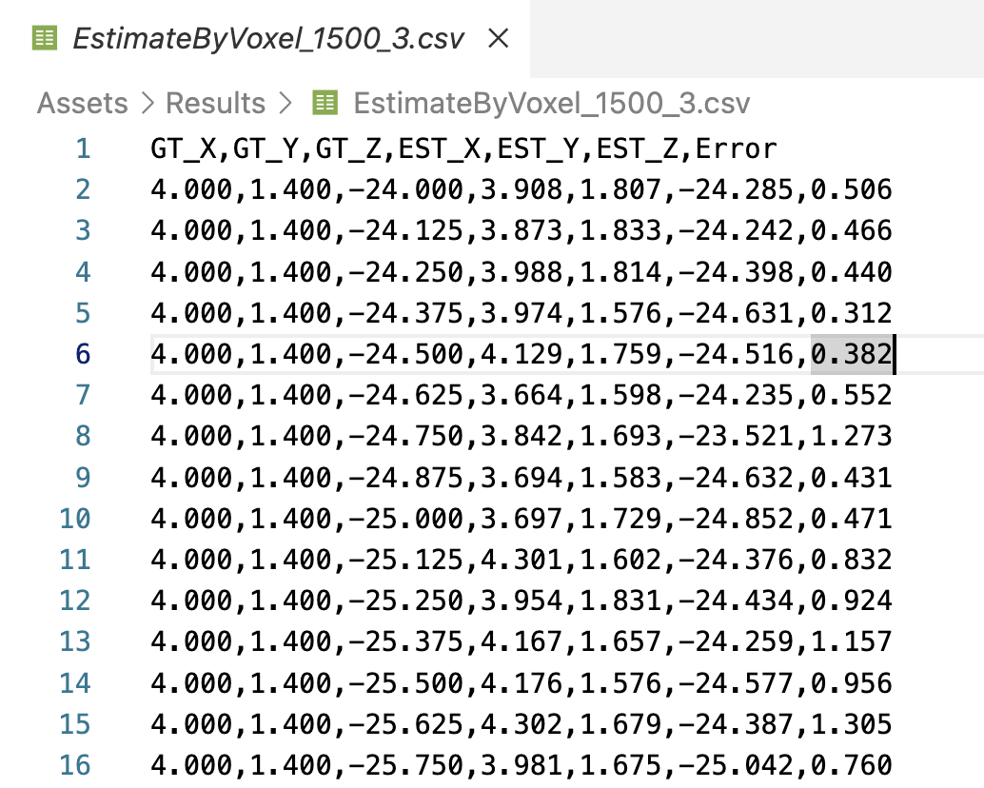
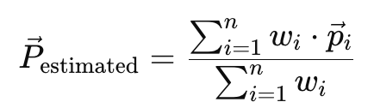
Ray Tracing Simulation - Output: Most likely voxel X_k(voxelSize = 0.5)

Slide 16
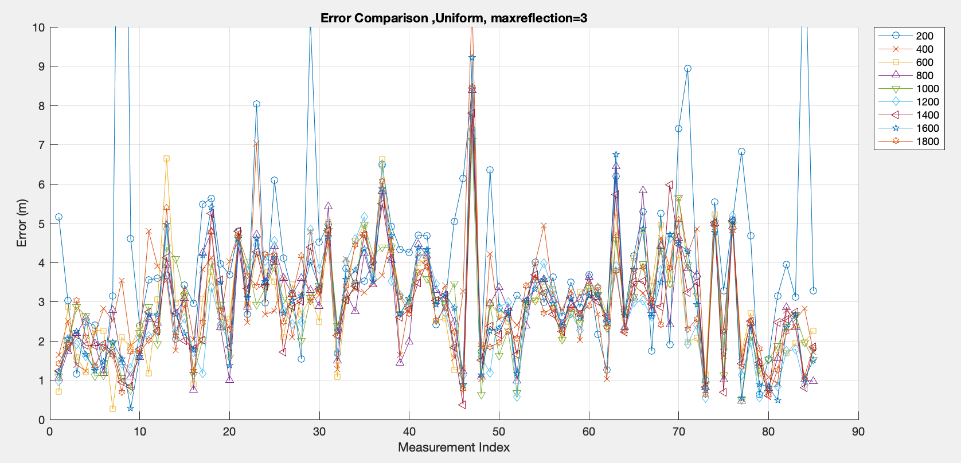
Ray Tracing Simulation - Result(made-data-test-1.mat)

Slide 17
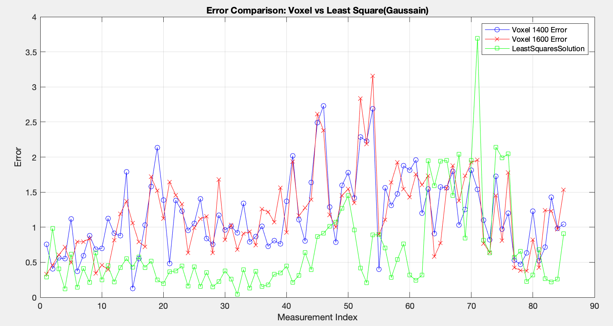
Ray Tracing Simulation - Result(made-data-test-1.mat)
CDF
95%的置信区间

Slide 18
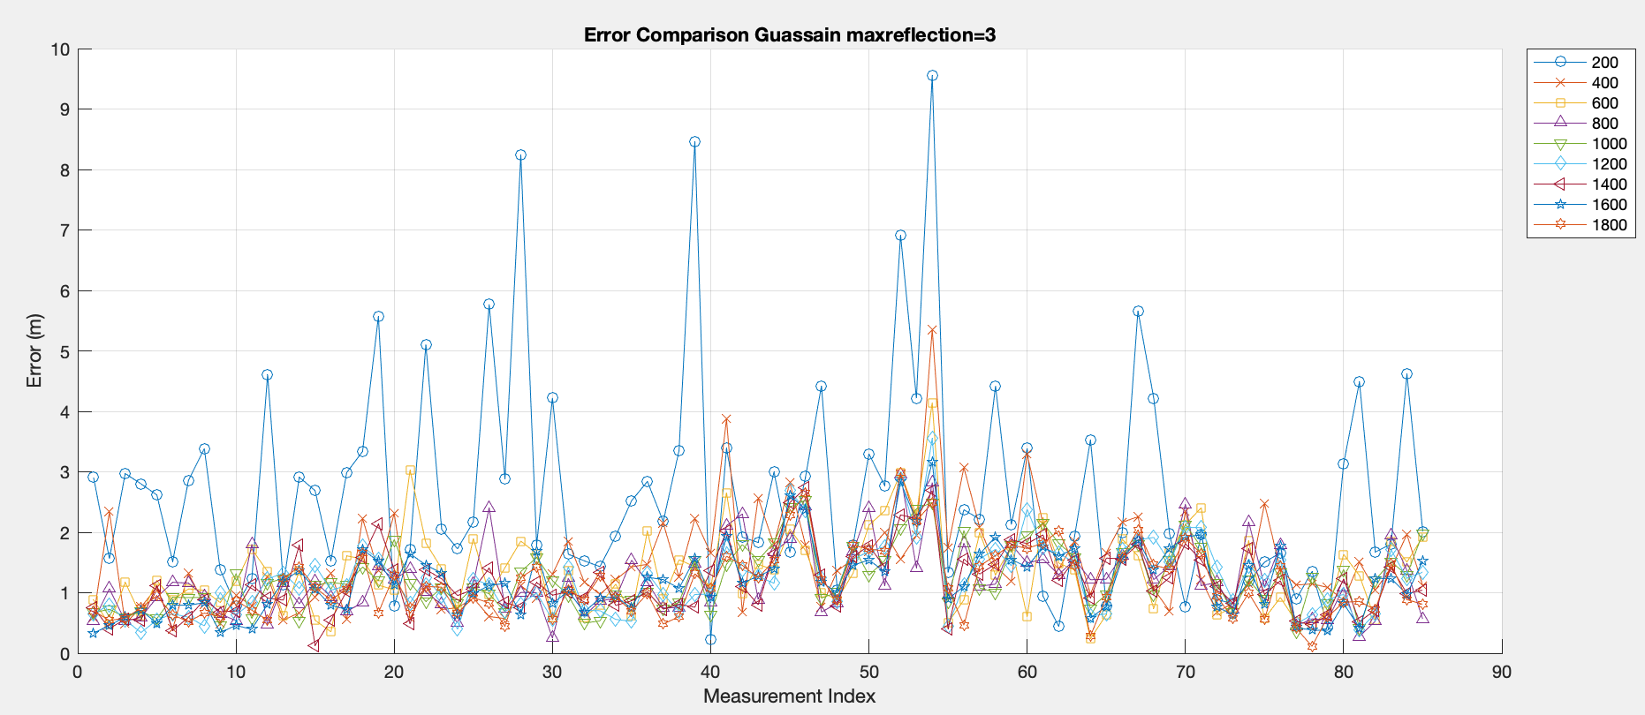
Ray Tracing Simulation - Result(made-data-test-1.mat)

Slide 19
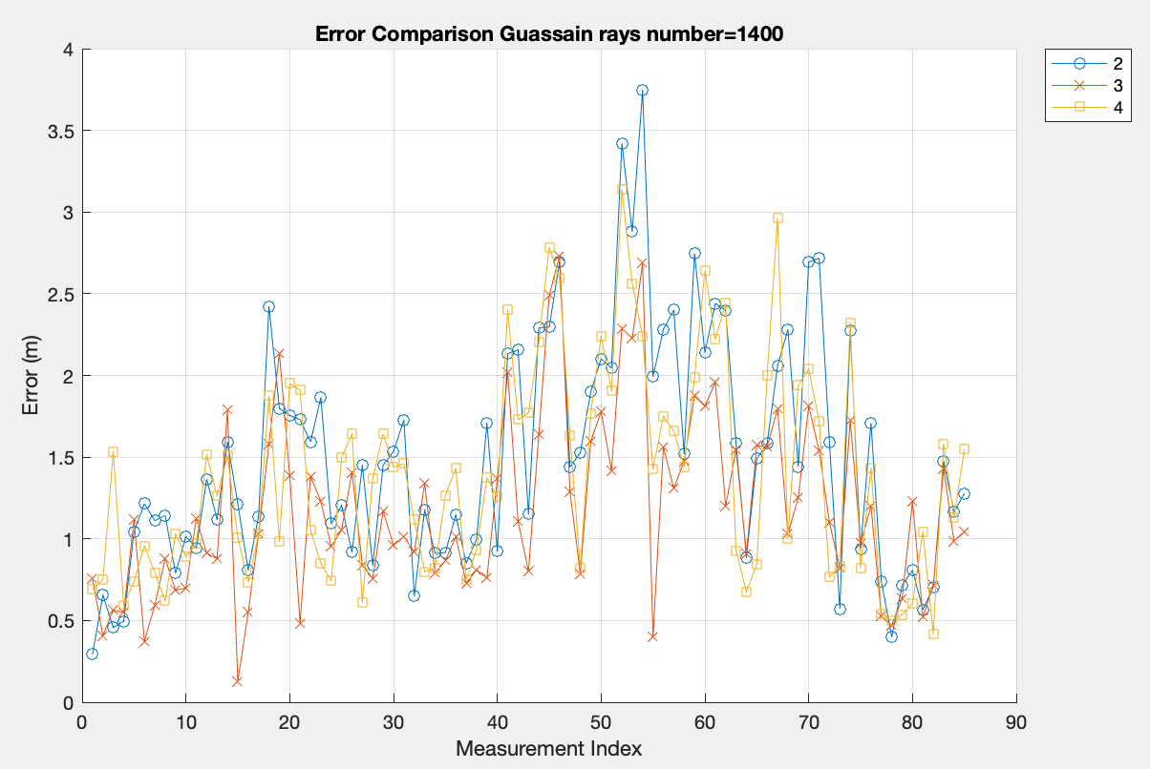
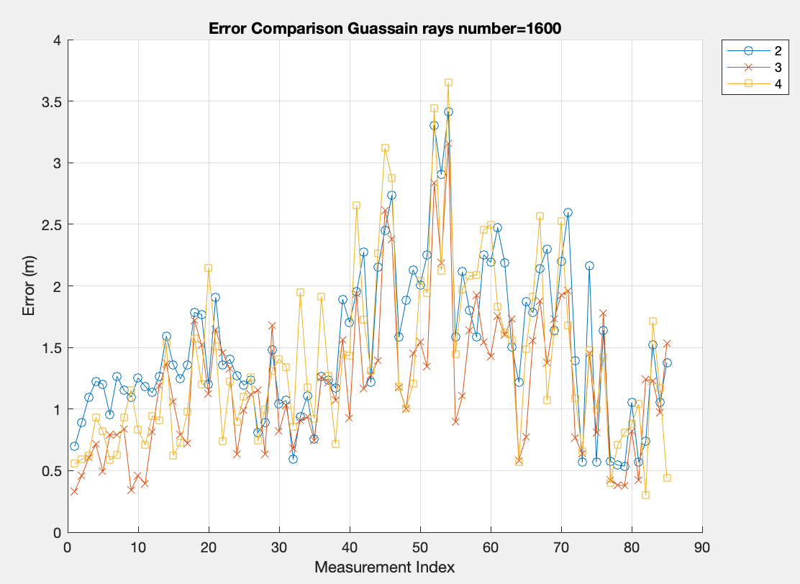
Ray Tracing Simulation - Result(made-data-test-1.mat)
When max reflections = 3, the overall error is smaller and more stable

Slide 20
Ray Tracing Simulation - Result(made-data-test-1.mat)

Slide 21
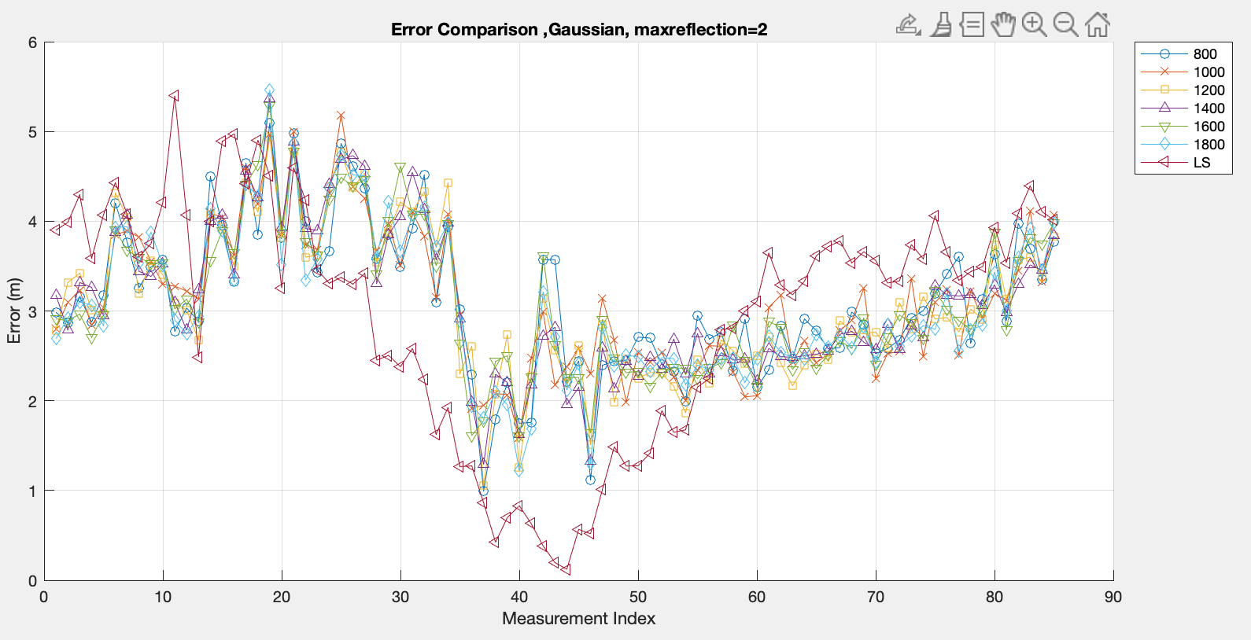
Ray Tracing Simulation - Result(made-data-test-2.mat)

Slide 22
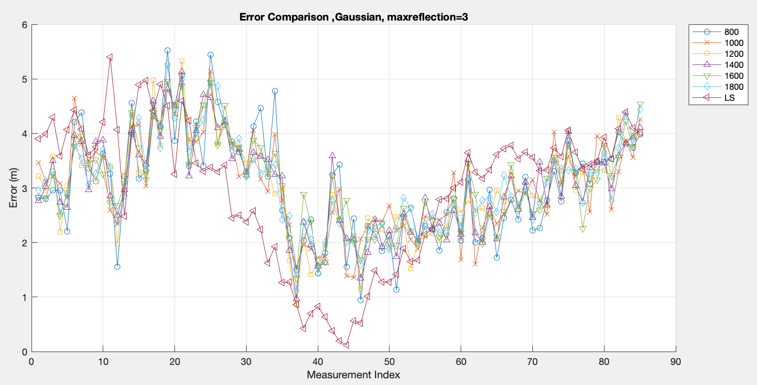
Ray Tracing Simulation - Result(made-data-test-2.mat)

Slide 23
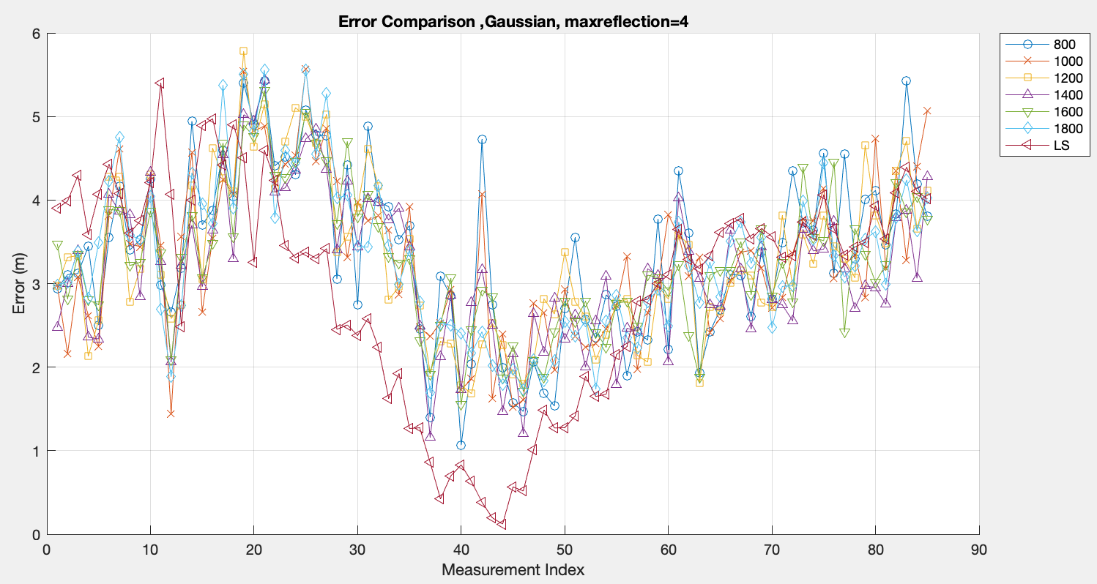
Ray Tracing Simulation - Result(made-data-test-2.mat)

Slide 24
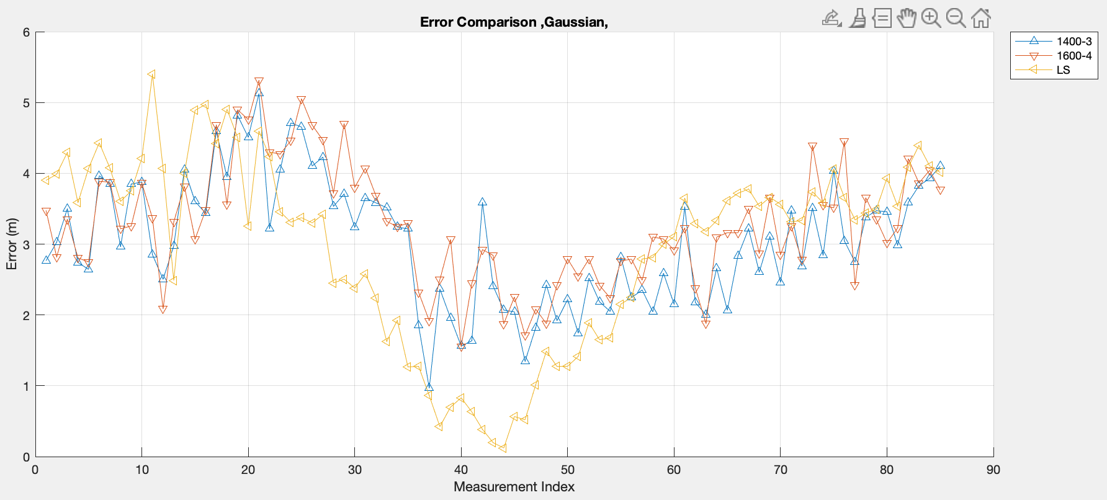
Ray Tracing Simulation - Result(made-data-test-2.mat)

Slide 25
References
V. Nguyen, V. Corlay, and N. Gresset, “Probabilistic ray-tracing aided positioning at mmWave frequencies”, Int. Conf. on Indoor Positioningand Indoor Navigation (IPIN), 2023.
V. Corlay, V. Nguyen, and N. Gresset, “Probabilistic positioning via ray tracing with noisy angle of arrival measurements”, IEEE Communications Letters, vol. 28, no. 10, Oct. 2024.
Fusion of Time and Angle Measurements for Digital-Twin-Aided Probabilistic 3D Positioning Vincent Corlay, Viet-Hoa Nguyen, Nicolas Gresset https://doi.org/10.48550/arXiv.2410.15237、
S. Deng, G. R. MacCartney, and T. S. Rappaport, “Indoor and Outdoor 5G Diffraction Measurements and Models at 10, 20, and 26 GHz,” NYU WIRELESS TR 2016-001, May. 2016.

Slide 26
Parameter selection for distribution
Dataset | AP | μ | k
made-data-test-1.mat | AP1 | [0.95,-0.20,-0.24] | 9.88
 | AP2 | [0.99,-0.16,-0.07] | 12.00
 | AP3 | [0.99,-0.12,-0.07] | 9.44
 | AP4 | [0.99,0.09,-0.14] | 39.04
made-data-test-2.mat | AP1 | [0.95,-0.20,-0.24] | 9.77
 | AP2 | [0.99,-0.15,-0.07] | 12.46
 | AP3 | [0.99,-0.10,-0.07] | 9.98
 | AP4 | [0.99,-0.09,-0.14] | 42.75
made-data-test-3.mat | AP1 | [0.95,-0.20,-0.24] | 10.52
 | AP2 | [0.99,-0.15,-0.07] | 12.46
 | AP3 | [0.99,-0.11,-0.08] | 9.46
 | AP4 | [0.99,0.09,-0.13] | 47.83

Slide 27
CONTATTI
xuan3.zhang@mail.polimi.it

